Slide 1

GENG-8900 MACHINE LEARNING
Instructor: Dr. Yasser Alginahi
K-Means Clustering
Date: 03-Nov-2023
Harshkumar Zaveri
Aeshita Dhiman
Gurpreet Singh Saini

Slide 2
Overview
Types of Machine Learning
Clustering
What is K-means clustering
Key Terminologies
K means algorithm
Evaluate quality of clusters
Advantages and Disadvantages
Implementation and code
Applications
References

Slide 3
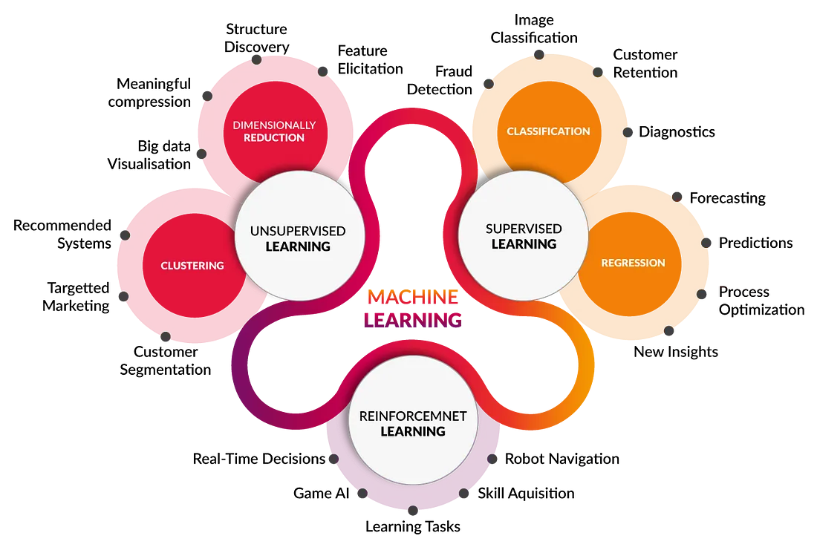
Types of Machine Learning
Types of Machine Learning [https://shorturl.at/pzNT9]

Slide 4
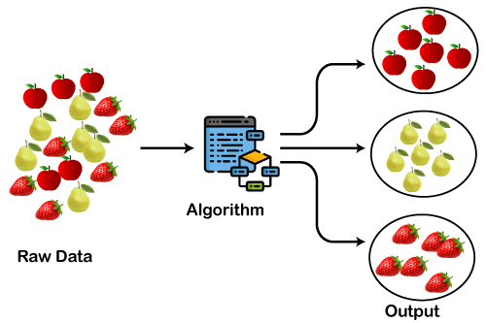
Clustering
Clustering is the process of arranging a group of objects in such a manner that the objects in the same group are more similar to each other than to the objects in any other group
Clustering [https://shorturl.at/hpyDE]

Slide 5
Clustering
5 essential clustering algorithms
K-Means
MeanShift
DBSCAN
Hierarchical clustering
BIRCH

Slide 6
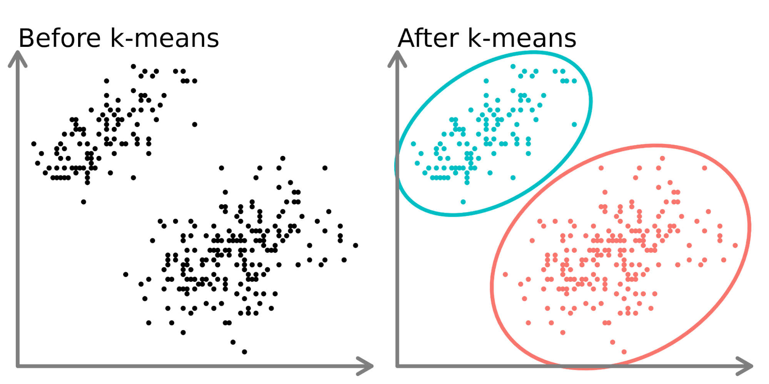
What is K-mean clustering?
K-means clustering is an unsupervised machine learning algorithm that partitions a dataset into K clusters
Such models aim to assign similar data points into distinct clusters or groups
K-means clustering [https://shorturl.at/kvPS6]

Slide 7
Key Terminologies
In ideal conditions for clustering to perform well the inter-cluster distance should be very high and the intra-cluster distance should be very low.
Based on these two distances we can measure the performance of clustering techniques using the Dunn index.
The Dunn Index is the ratio of the smallest distance between observations not in the same cluster to the largest intra-cluster distance.
Inter-cluster and Intra-cluster distance [https://shorturl.at/fzBU2]

Slide 8
Key Terminologies
Data Points: These are individual data instances or observations that are grouped into clusters based on their similarities.
Centroids: Centroids are the central points of each cluster. They represent the mean or average of the data points within that cluster.
Clusters: Clusters are groups of data points that are similar to each other and dissimilar to data points in other clusters. Each data point belongs to one and only one cluster.
K-value: K refers to the number of clusters you want to create in the dataset. It is a hyperparameter that you must choose before running the K-means algorithm.
Keywords [https://shorturl.at/fzBU2]

Slide 9

Key Terminologies
This algorithm takes the data points and gives the predefined set of clusters. Consider dataset D={x₁,x₂……,x_{n}} has n points with k clusters(S₁,S₂..S_{k}) and each cluster assigned with one centroid( C₁,C₂, C₃..C_{k}).
Every point in the dataset is assigned to the set (Si) depending on the nearest centroid to it.
The centroid(C_{i}) is the mean point to all the other points in the given set of points (S_{i}). It is calculated as below:

Slide 10
K-Means Algorithm
Step 1: Identify number of clusters
Step 2: Initialize Cluster Centroids
Step 3: Assign Datapoints to Centroids
Step 4: Re-evaluate cluster mean
Step 5: Repeat steps 3 – 4 till convergence or a certain number of iterations
K-means Algorithm[https://shorturl.at/ouMOW]

Slide 11
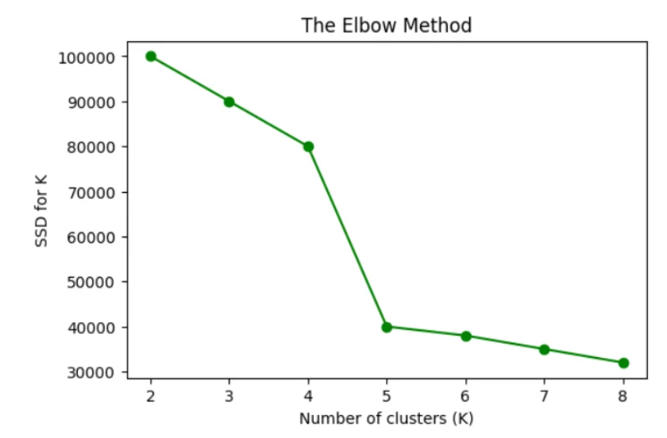
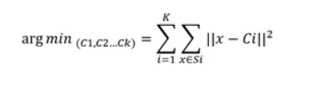
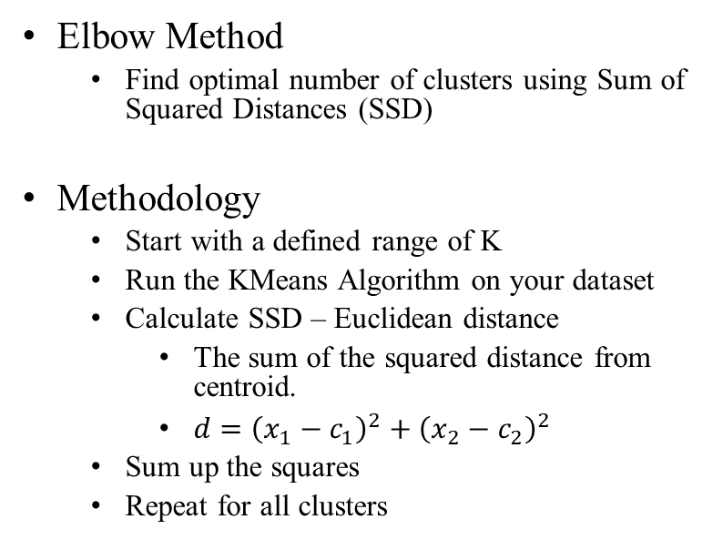
K-Means Algorithm
Identify number of clusters
Elbow Method
Find optimal number of clusters using Sum of Squared Distances (SSD)
Methodology
Start with a defined range of K
Run the KMeans Algorithm on your dataset
Calculate SSD – Euclidean distance
The sum of the squared distance from centroid.
$d={\left(x_{1}−c_{1}\right)}^{2}+{\left(x_{2}−c_{2}\right)}^{2}$
Sum up the squares
Repeat for all clusters
Elbow Method [https://shorturl.at/glJM8]

Slide 12
Assign initial Centroids
K-Means Algorithm
At Random
Basic method
KMeans ++
Smart centroid initialization
Initial centroid assigned randomly
Rest of the centroids based on maximum squared distance to spread out centroids
K-Means Iteration [https://shorturl.at/jwWZ7]

Slide 13
K-Means Algorithm
Assign data points to clusters
Using distance measures like Euclidian distance to find the nearest centroid to the data point
What Happens if same distance?
Choose any cluster at random
K-Means Iteration [https://shorturl.at/jwWZ7]

Slide 14
K-Means Algorithm
Assign data points to nearest centroid to create clusters
K-Means Iteration [https://shorturl.at/jwWZ7]

Slide 15
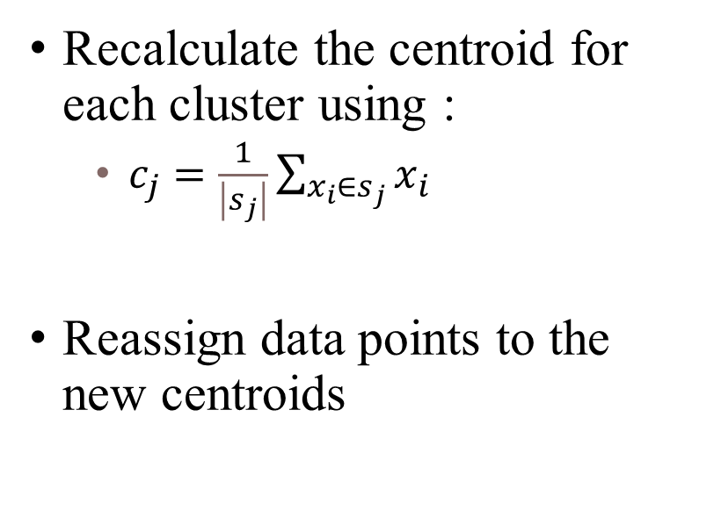
Update centroids and clusters
K-Means Algorithm
Recalculate the centroid for each cluster using :
$c_{j}=\frac{1}{\left|s_{j}\right|}\sum_{x_{i}∈s_{j}}{x_{i}}$
Reassign data points to the new centroids
K-Means Iteration [https://shorturl.at/jwWZ7]

Slide 16
Repeat data point assignment and centroid update until convergence
K-Means Algorithm
Convergence :The state where there is a very small update in the new centroids over the old centroids
K-Means Iteration [https://shorturl.at/jwWZ7]

Slide 17
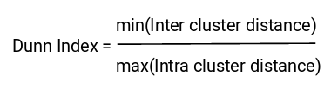
Evaluate quality of Cluster
Inertia
It tells us how far the points within a cluster are
the sum of distances of all the points within a cluster from the centroid of that cluster
Euclidean distance is often used as the distance metric
We calculate this for all the clusters; the final inertial value is the sum of all these distances
the distance between them should be as low as possible
Dunn Index
Dunn index is the ratio of the minimum of inter-cluster distances and maximum of intra-cluster distances.
The more the value of the Dunn index, the better the clusters will be
Clusters are far apart
Clusters are compact

Slide 18
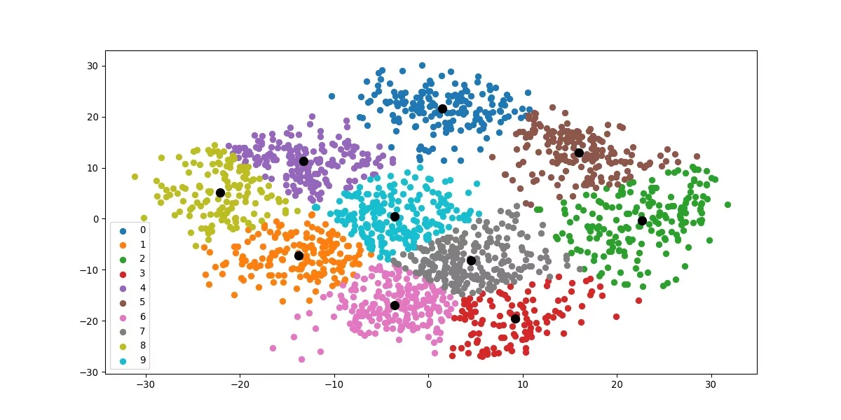
Advantages
Easy to implement
Result can be Interpreted seamlessly
Produce consistent results
Can adapt to new examples
The biggest advantage: UNSUPERVISED LEARNING
K-mean clustering graph [https://tinyurl.com/2s3zsdrx]

Slide 19
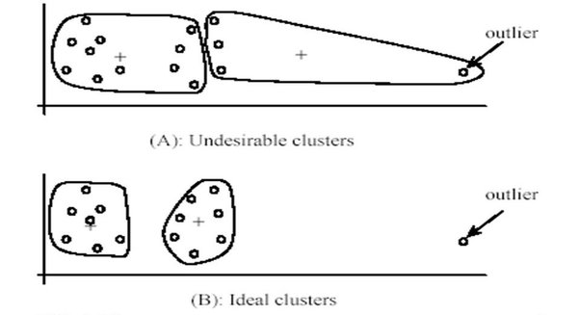
Disadvantages
Choosing K manually
Clustering outliers
Different random seeds can cause the algorithm to converge to different local minima instead of the global minimum
It assumes that clusters are spherical and have similar variance
Effect of outlier on clustering [https://tinyurl.com/c29dyzc4]

Slide 20
Implementing K-Mean on a real dataset
The dataset is from an automobile company, which have divided there existing customer into four groups and want to predict the group for new customer.
The dataset have following columns: Unique ID, Gender, Marital status, Age, Graduated, profession, Work experience, Credit score, Family size and category group
What are we going to do? Remove the category that’s already defined and cluster it by ourself.

Slide 21
Code!!!
Import pandas as pd
from sklearn.cluster import Kmeans
df = pd.read_csv("Train.csv")
df = df.drop(["Segmentation", "ID"], axis="columns")
df=df.dropna()
df = df.reset_index()
df = df.drop("index", axis="columns")
df_new = pd.get_dummies(df)
df_kmeans = pd.get_dummies(df, drop_first=True)
kmeans_model = KMeans(n_clusters=3)
clusters = kmeans_model.fit_predict(df_kmeans)
df_kmeans.insert(df_kmeans.columns.get_loc("Age"), "Cluster", clusters)
df_kmeans.sample(5, random_state=44)
K-mean Implementation and code [http://bit.ly/49kADke]

Slide 22
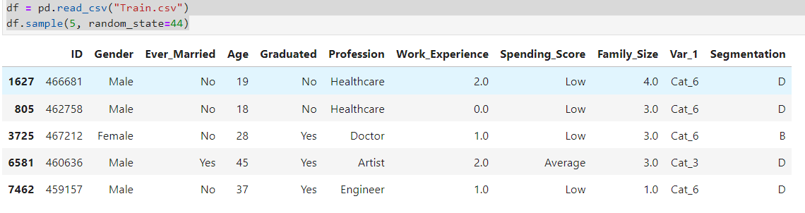
Implementation
Read the dataset

Slide 23
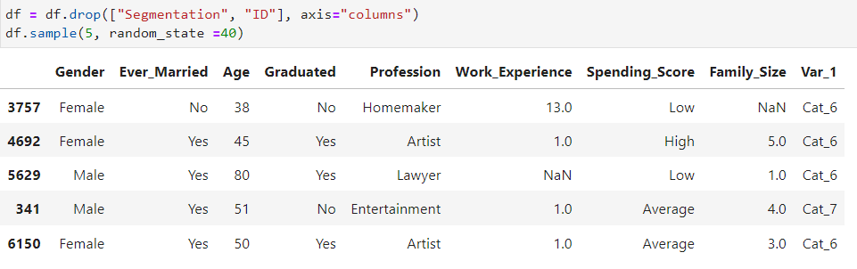
Implementation
Remove columns which we do not need

Slide 24
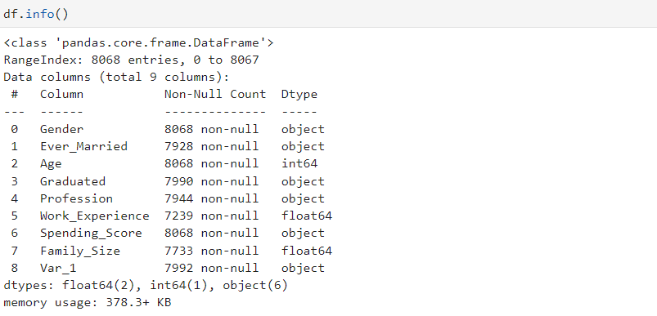
Implementation
Detail information about the dataset

Slide 25
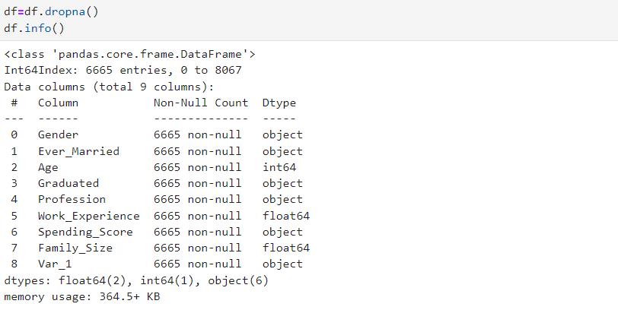
Implementation
Data Cleaning

Slide 26
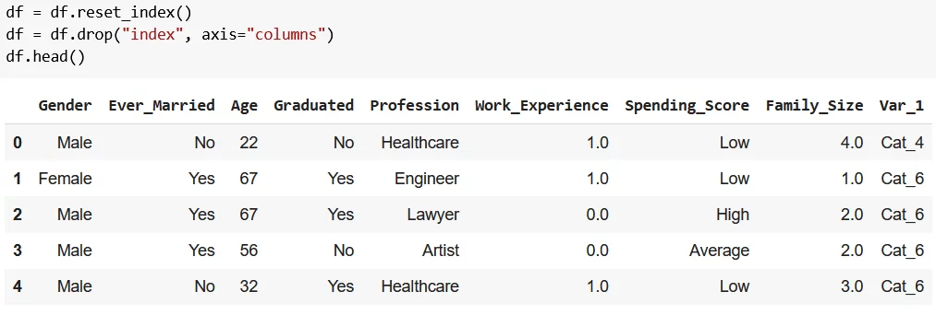
Implementation
Dataset after Data cleaning and preprocessing

Slide 27
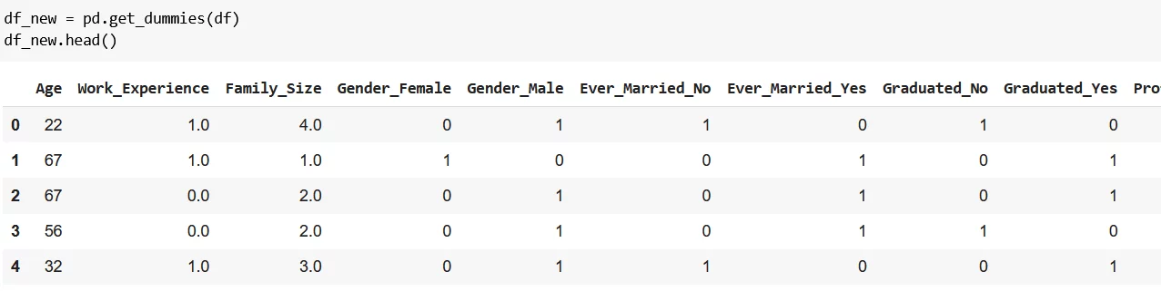
Implementation
Formatting the data for K-Mean clustering

Slide 28
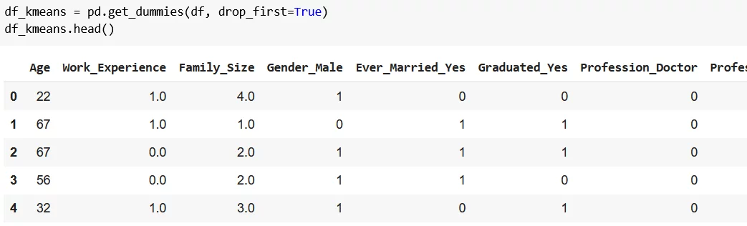
Implementation
Formatting the data for K-Mean clustering

Slide 29
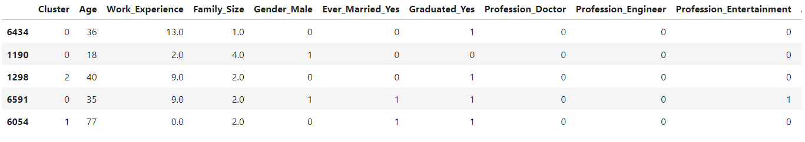
Implementation
Create K-mean clustering model

Slide 30
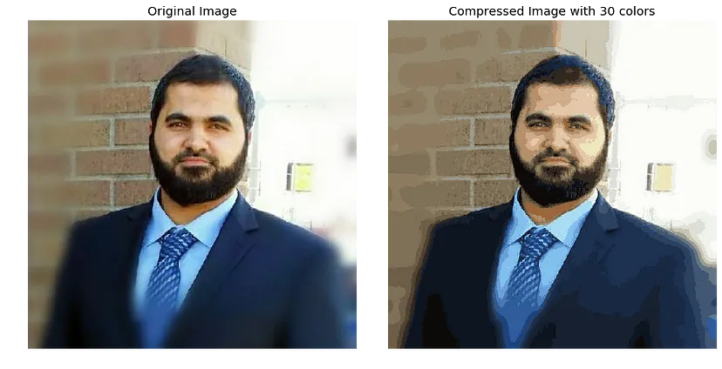
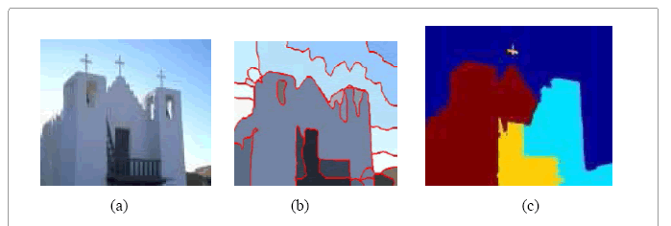
Applications
Image Compression
Image segmentation
Evaluating performance – Academic, work or credit
Image compression using K-mean [http://tiny.cc/52gdvz]
Image segmentation using K mean [http://tiny.cc/52gdvz]

Slide 31
References
What is K-means Clustering [https://rb.gy/eqh727]
K-means Algorithm [https://rb.gy/anbipp]
Elbow Method [https://rb.gy/jdjn28]
K-mean Implementation and code [http://bit.ly/49kADke]
Advantages and Disadvantages [https://bit.ly/40qKkda]

Slide 32


